Slide 1
Classes and Methods

Slide 2

Overloading methods
OverloadDemo
Type Conversions
OverloadDemo2
Notes:
Clipart : crazywebsite.com

Slide 3

Overloading Constructors
OverloadCons

Slide 4
Using Objects as Arguments
Rectangle
OverloadCons

Slide 5
passing by value and by reference
RectangleDemo1

Slide 6
Additional
Call by value vs call by reference
Returning objects from methods
public vs. private access specifiers
final keyword
It is a common coding convention to choose all uppercase identifiers for final variables.
Variables declared as final do not occupy memory on a per-instance basis.
final variable is essentially a constant.

Slide 7
Additional
Recursion

Slide 8
static keyword
static variable
Methods declared as static have several restrictions:
They can only call other static methods.
They must only access static data.
They cannot refer to this or super in any way.
static block that gets executed exactly once, when the class is first loaded

Slide 9
Arrays :One dimensional
Declaring
type var-name[ ];
int month_days[];
array-var = new type[size];
month_days = new int[12];
Assigning values
Displaying values

Slide 10
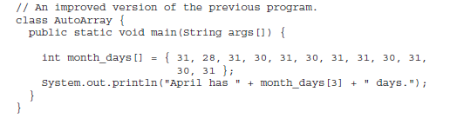

Arrays :One dimensional
Initialization
Note :: Index out of range is checked

Slide 11
Arrays: Multidimensional
int twoD[][] = new int[4][5];
int twoD[][] = new int[4][]; twoD[0] = new int[1]; twoD[1] = new int[2]; twoD[2] = new int[3]; twoD[3] = new int[4];
Initialization
Displaying
Assignment

Slide 12
Arrays:: Alternative syntax
One Dimensional
int al[] = new int[3]; int[] a2 = new int[3];
Two Dimensional
char twod1[][] = new char[3][4]; char[][] twod2 = new char[3][4];

Slide 13
Arrays are Objects
length instance variable
Stack class

Slide 14
Strings
Strings are implemented as objects
String is Not a simple type
String is NOT an array of characters

Slide 15
Strings::objects
Every string created is an object
String constants are actually string objects
System.out.println("This is a String, too");

Slide 16
Strings are immutable
always create a new one that contains the modifications if needed
Java defines a peer class of String, called StringBuffer

Slide 17
Strings::Construction
String myString = "this is a test"; System.out.println(myString);
String myString = "I" + " like " + "Java.";

Slide 18
Strings::methods
boolean equals(String object)
int length( )
char charAt(int index)

Slide 19
Command-line arguments
passing information into a program when you run it
by passing command-line arguments to main( )
A command-line argument is the information that directly follows the program’s name on the command line when it is executed

Slide 20
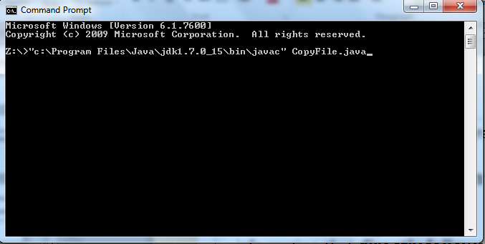
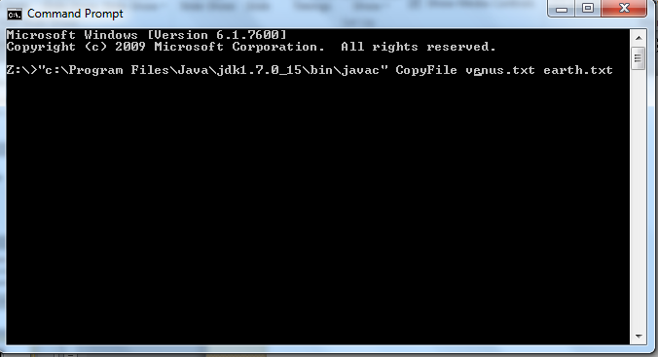
Compile CopyFile.java
venus.txt and earth.txt are command line arguments

Slide 21
Accessing command line arguments
venus.txt and earth.txt
Copied to

Slide 22
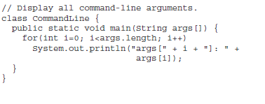
Accessing command line arguments
venus.txt is copied to args[0]
earth.txt is copied to args[1]

Slide 23
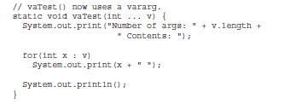
Varargs: variable length arguments
Syntax using 3 …
Definition

Slide 24

Varargs: variable length arguments
Calling

Slide 25
Varargs: Restrictions
int doIt(int a, int b, double c, int ... vals, boolean stopFlag) // Error!
int doIt(int a, int b, double c, int ... vals, double ... morevals) // Error!
variable-length parameter must be the last parameter declared by the method

Slide 26
Varargs: Overloading
static void vaTest(int ... v)
static void vaTest(boolean ... v)
static void vaTest(String msg, int ... v)

Slide 27
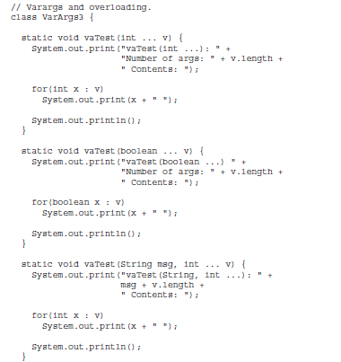
Varargs: Overloading

Slide 28
Varargs: Overloading (Ambiguity)
Definintion
static void vaTest(int ... v)
static void vaTest(boolean ... v)
Calling
vaTest(1, 2, 3); // OK
vaTest(true, false, false); // OK
vaTest(); // Error: Ambiguous!

